Slide 1

Brief Introduction to HL7 FHIR for SMART Guidelines

Slide 2
Agenda 1) What is FHIR 2) What is a machine readable L3 SMART Guideline 3) Skills to be covered for successful L3 adoption

Slide 3
What is interoperability?
The ability of multiple systems, applications, and devices to communicate with one another by accessing, exchanging and making use of data exchange standards in a systematic way to achieve health goals.
Source: Digital Health: Planning National Systems training
Notes:
https://digitalhealth.course.tc/catalog/public-dhpns

Slide 4
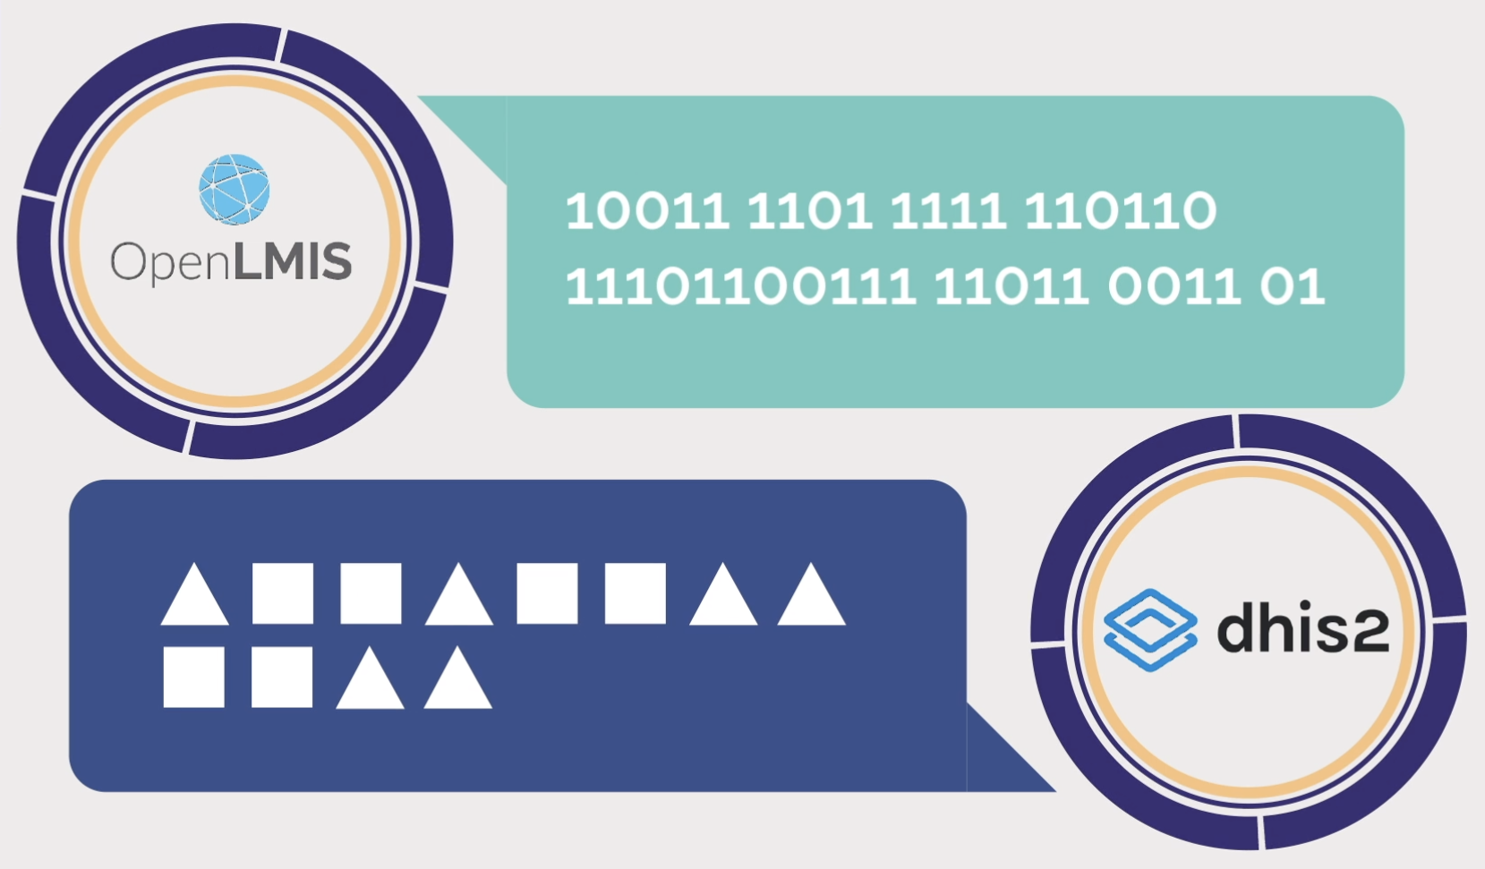
What is interoperability?
Standards make interoperability easier and more cost efficient!
They are a set of rules that:
Allow information to be shared in a uniform and consistent manner across any digital application
Are approved and published by an authoritative, official organization
Are key to how different digital applications can talk to each other.
Source: Digital Health: Planning National Systems training

Slide 5

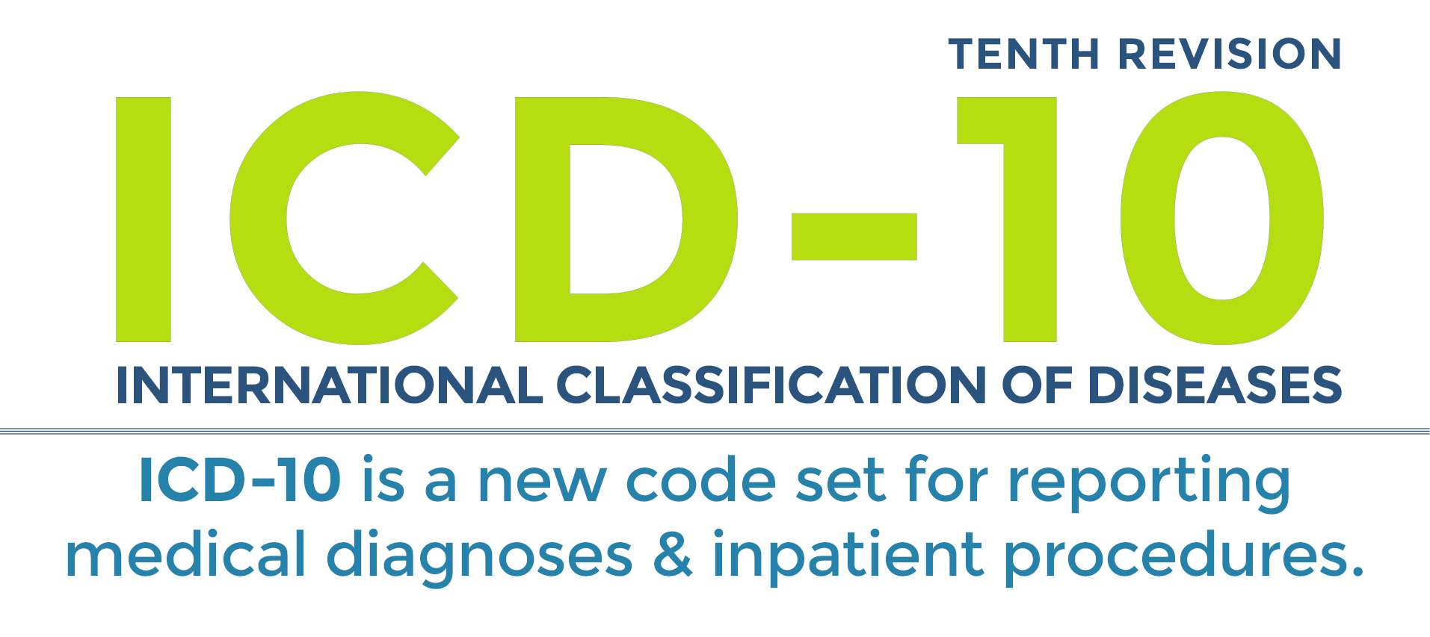







Two types of Data Exchange Standards
Semantic standards (vocabulary):
What you say, the actual terms
Syntactic standards (grammar):
How you say it, a set of rules, relationships between vocabulary terms
Source: Digital Health: Planning National Systems training
Notes:
Speaker Notes:
Key message:
Talking points:
Pacing:
Poll: NO
Citation:

Slide 6

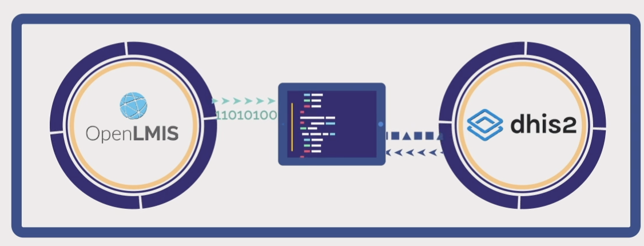
Integration versus Interoperability
Integration
Interoperability
When two applications directly exchanging information, often involving one or both systems needing to be changed to exchange the information
A way that multiple applications can exchange information without changing the actual application, often through the aid of standards and middleware such as health information exchange (HIE)
Source: Digital Health: Planning National Systems training

Slide 7
Business motivations for standards
Motivations for standards:
Be compatible with other systems
Prepare internationalization
Save effort
Reuse knowledge embedded in standards
Foster communities
Follow directives
Quality assurance
Risk mitigation
Motivations for not using standards:
Project deadlines
Knowledge / resources / culture
Customization

Slide 8
FHIR Overview

Slide 9
What does FHIR mean
F
H
I
R
Fast (to model and to implement)
Health (why we’re here)
Interoperability (ditto)
Resources (the core data models)

Slide 10
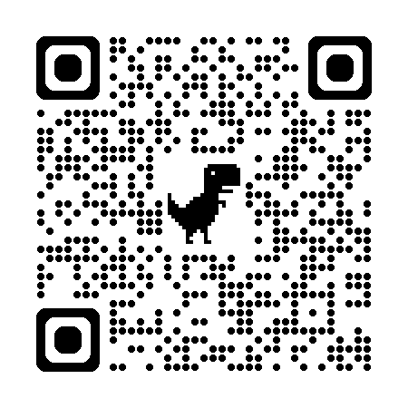
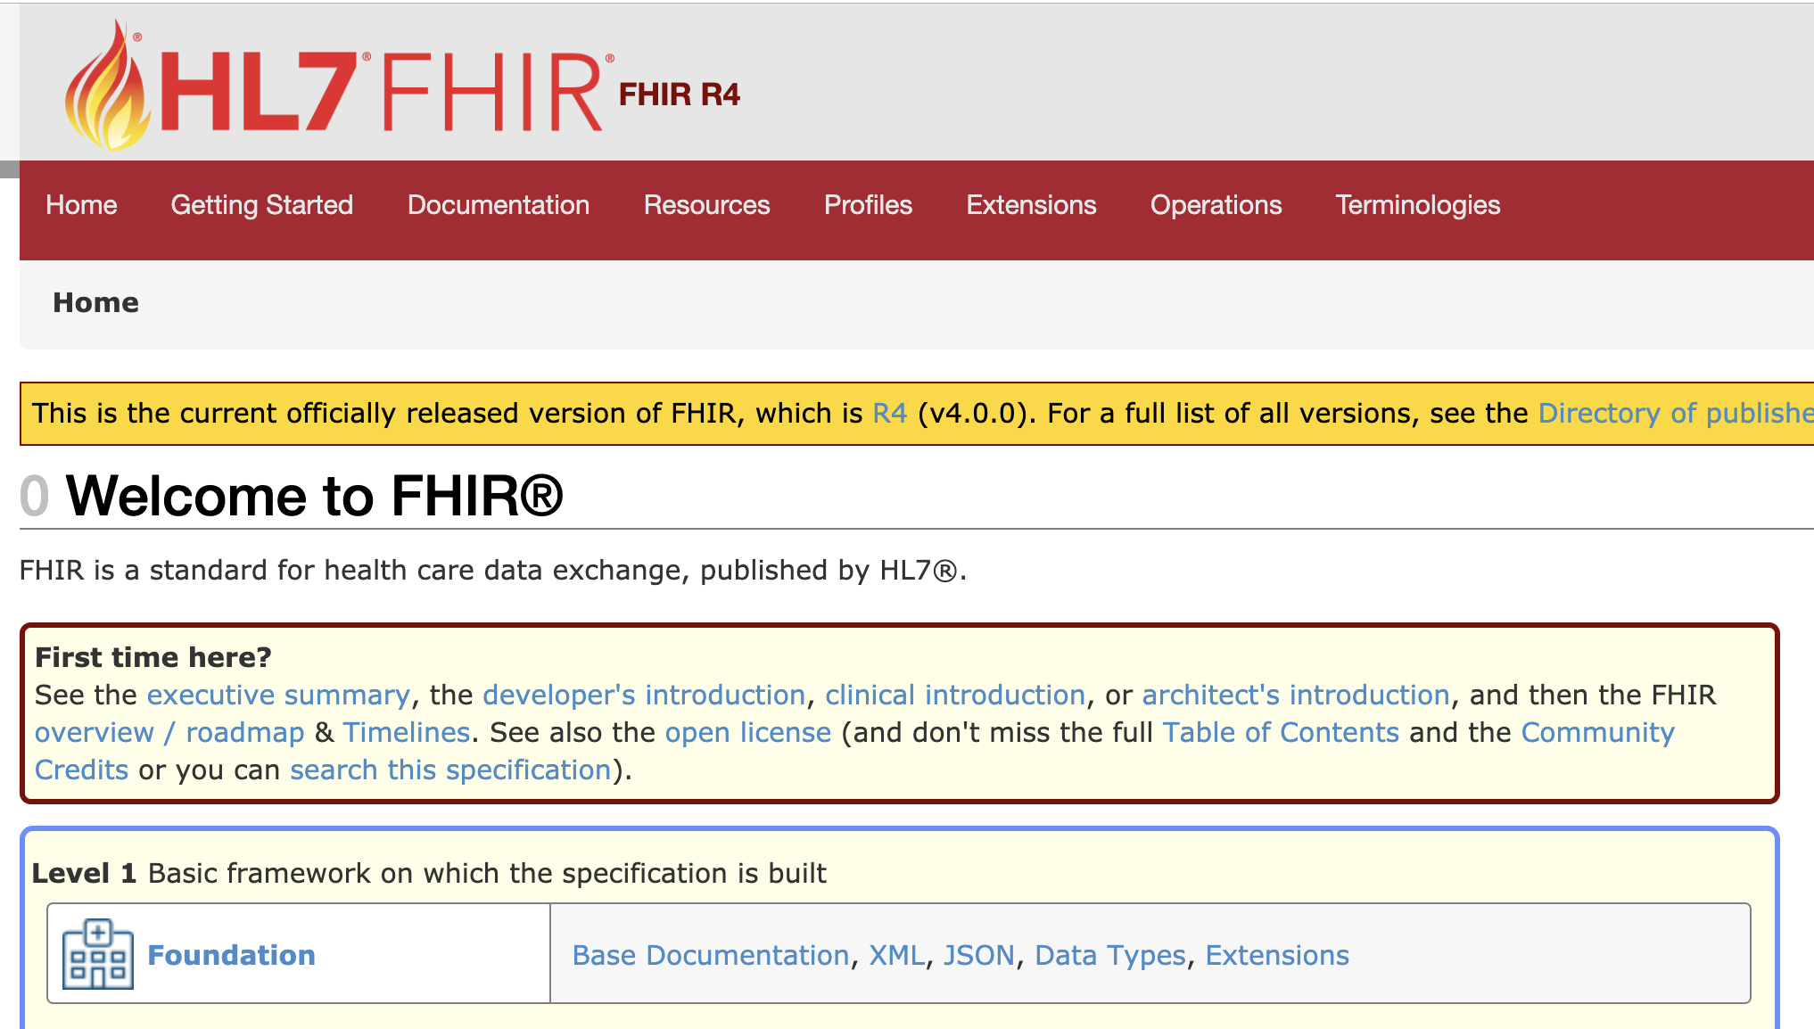
Navigating FHIR*
http://hl7.org/fhir
* these next set of slides adapted from James Agnew

Slide 11
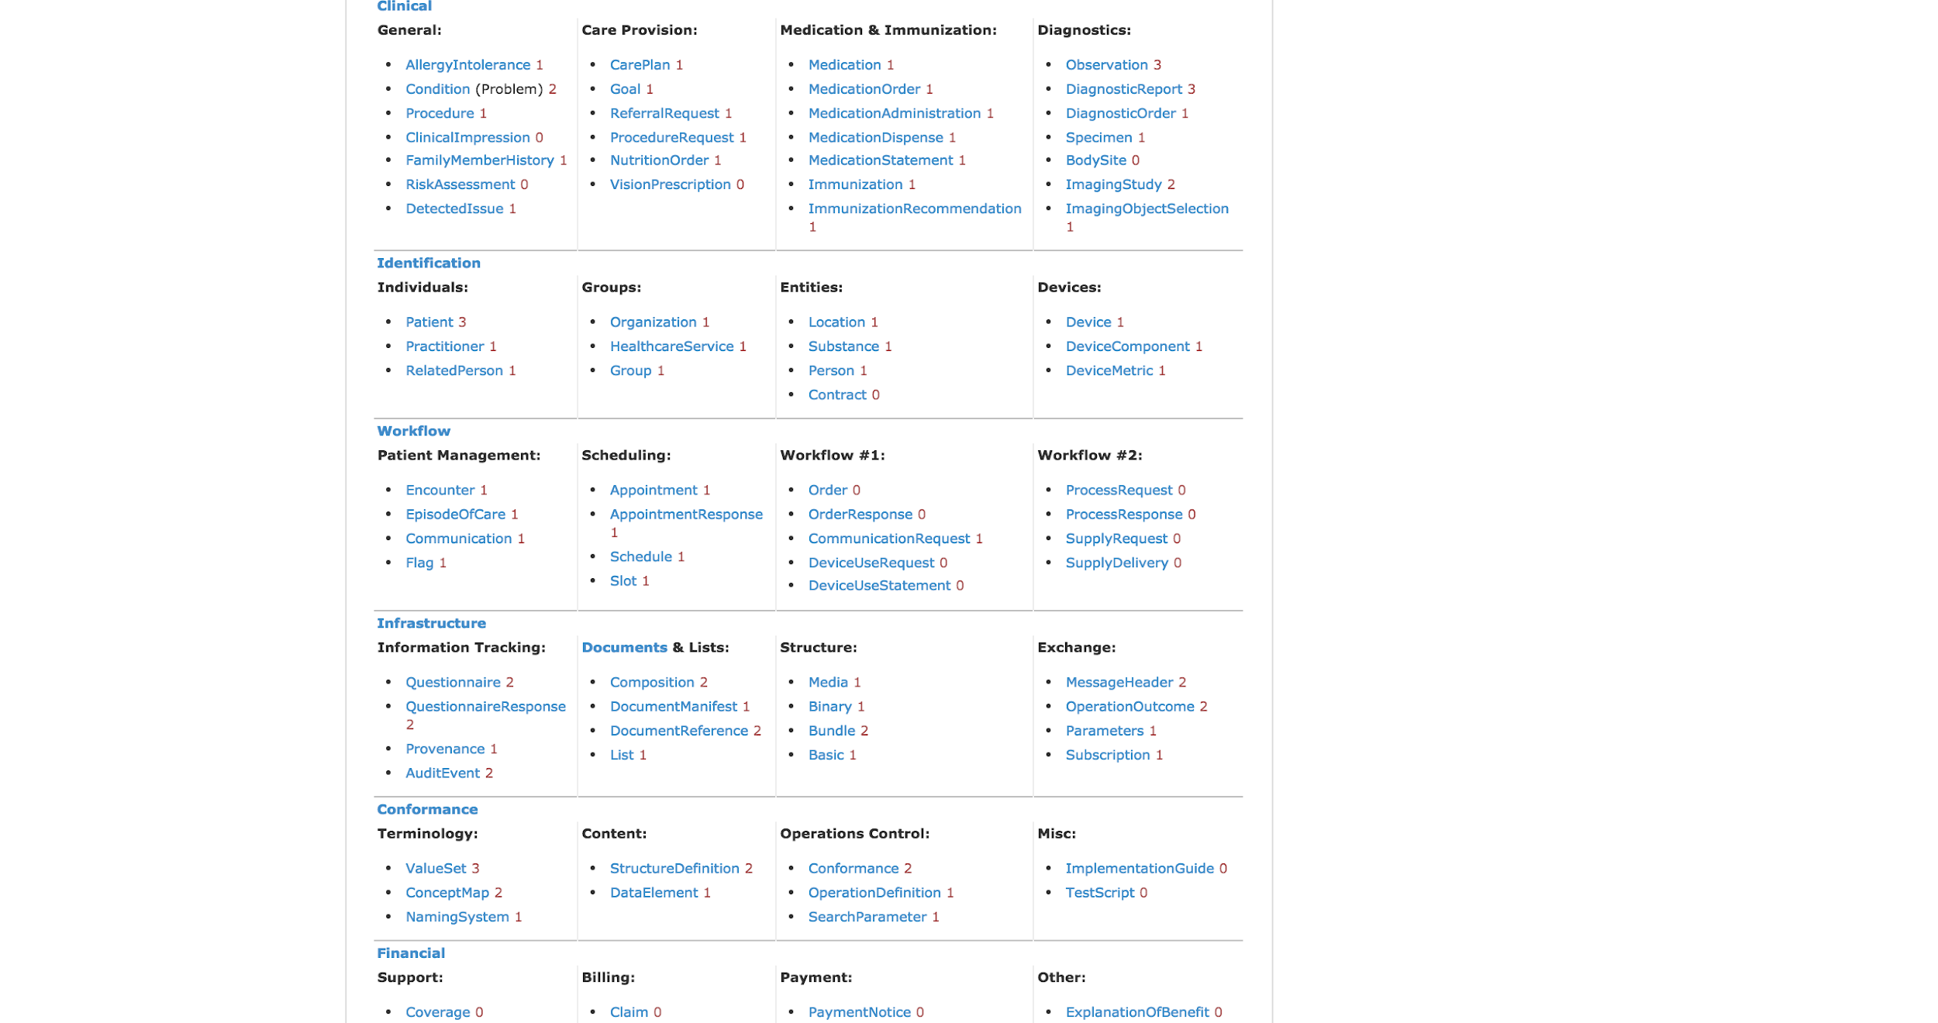
HL7 FHIR Data Model

Slide 12
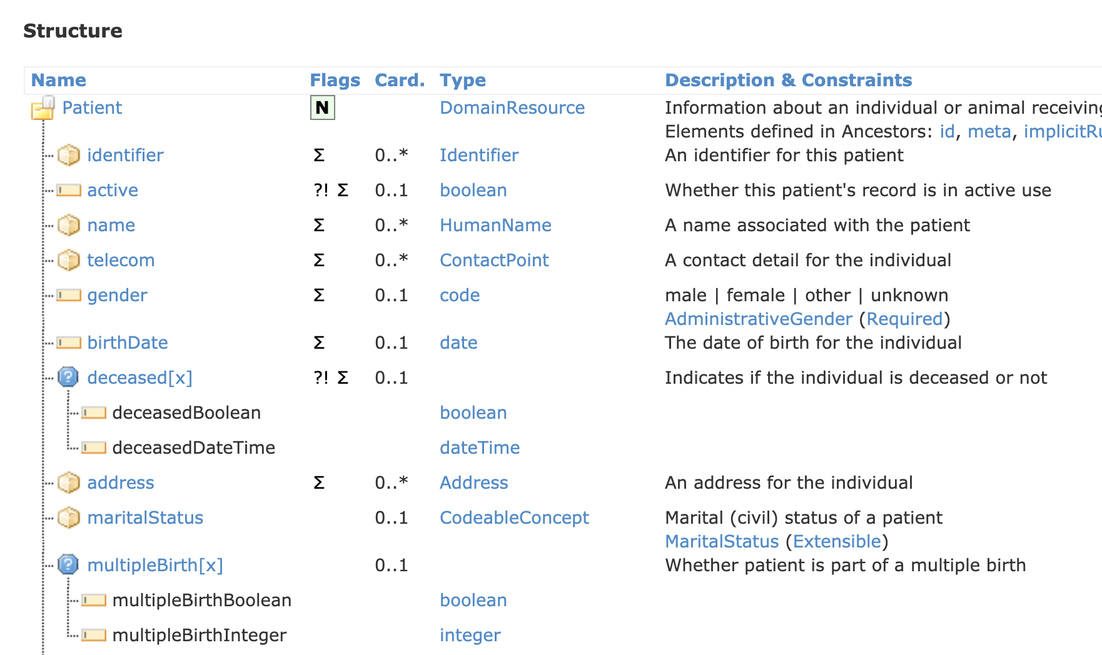
Navigating FHIR

Slide 13
Elements in the model

Slide 14
Cardinalities

Slide 15
Data Types

Slide 16
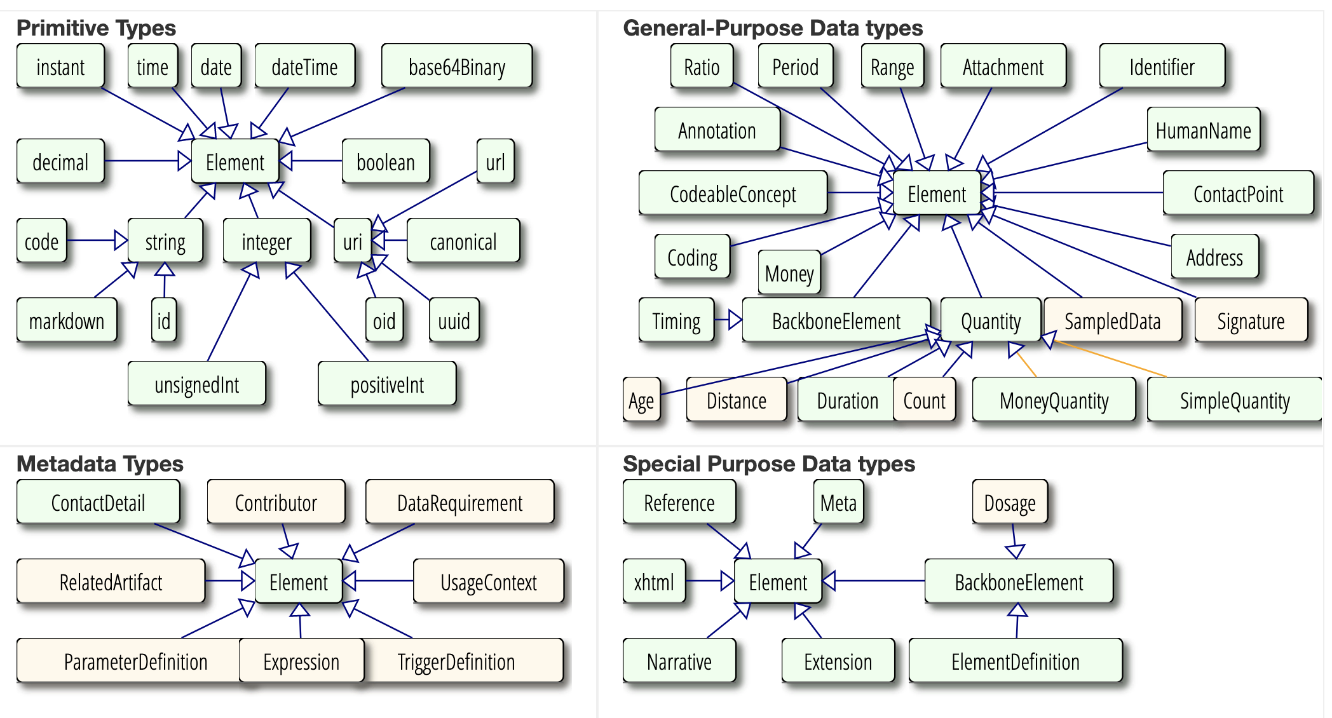

Slide 17
Vocabulary Binding
ValueSet
Strength

Slide 18
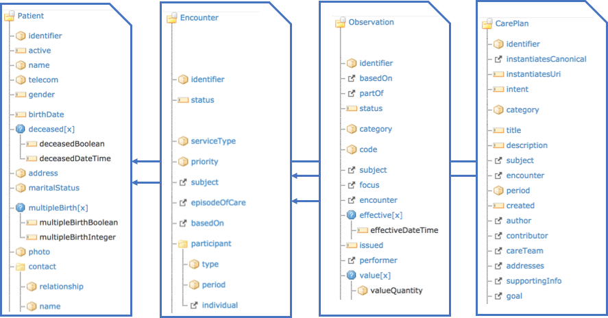
HL7 FHIR Data Model and Clinical Care Workflow

Slide 19
Some Key Resources: Clinical
Patient: An individual receiving healthcare services
Practitioner: An individual delivering healthcare services
Condition: A statement about a condition for a patient
Observation: An observed “thing” about a Patient, e.g. lab test, measurement, qualitative assessment
MedicationRequest: An order for meds
MedicationStatement: A statement (list) of current or discharge meds
Questionnaire / QR: Electronic “forms”

Slide 20
FHIR and SMART Guidelines

Slide 21
The SMART Guidelines provide guidance on the health content component of the three components required for a digital health intervention
Health Content
Information that is aligned with recommended health practices or validated health content
Digital Health Interventions
A discrete function of digital technology to achieve health sector objectives
Digital Applications
ICT systems and communication channels that facilitate delivery of the digital interventions and health content
SMART Guidelines provides the normative health content, mapped to interoperability standards
Notes:
So, we have created the SMART Guidelines, which are intended to provide Health Content that is aligned with WHO recommendations.
As part of any digital health intervention, high quality health content will be necessary to ensuring that the digital health intervention is adhering to best practice; and the SMART Guidelines provide this normative content in a way that facilitates adoption of it into digital systems.

Slide 22
SMART Guidelines are a new approach to representing WHO content as digital health components to preserve fidelity and accelerate uptake
Standards-based, Machine Readable, Adaptive, Requirements-based, Testable
EXISTING MODEL WITH ENHANCEMENTS
PREPARING TO GO DIGITAL
INTEROPERABLE DIGITAL COMPONENTS
CUSTOMIZABLE SOFTWARE
ADVANCED ANALYTICS FOR PRECISION HEALTH
Narrative
Operational
Machine Readable
Executable
Dynamic
Reinforces operational specificity in existing guidelines
Digital curation of recommendations
Panels include informatics and standards experts
Consolidation of L1 content
Digital Adaptation Kit (DAK) – requirements document
Human-readable components
Describes how a digital tool should function
FHIR Implementation Guide (IG)
Based on Clinical Practice Guidelines IG
Software agnostic
Fully executable software tools
Mechanism for real-time updates
Interoperate with national systems
Advanced analytics for greater local relevance and precision
AI-based decision support
Notes:
The SMART Guidelines has a 5 layer framework to represent WHO content has digital health components.
The first layer, the narrative guidelines – is what WHO currently publishes but with greater precision and greater inputs from health informaticians
The second Operational layer – or more commonly known as the Digital Adaptation Kits (DAKS) - provide a "business requirements document" that is based on all the narrative guidelines and guidance that exists for a health domain. Business requirements documents are documents that every technologist needs to prepare in order to design and build a digital tool. The Digital Adaptation Kits consolidate the requirements across the various guidance documents and puts them in a format that is more easily readable for technology vendors.
The third Machine Readable layer – provides the interoperability standards that are needed in the format of a FHIR (Fast health care interoperability resources) implementation guide. This is software agnostic standards that convert the DAK content into software code.
The fourth layer – is the executable layer. This provides a reference software that countries can then adapt and use.
And the Fifth layer – is forward looking. We don't have this yet, but the idea is that if countries are collecting and exchanging data in a standardized format, we would be able to collect information direct from countries in order to inform guidelines development – in addition to the existing mechanisms based on systematic reviews.

Slide 23

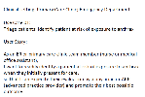
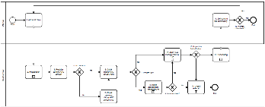
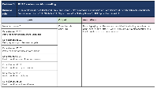
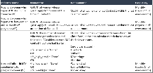
Components of a L2 Digital Adaptation Kit (DAK)
1
2
3
4
Health Interventions & Recommendations
Generic Personas
User Scenarios
Business Processes & Workflows
Relevant health interventions and recommendations from the WHO guideline and guidance
Roles, responsibilities, and essential interventions performed by targeted personas
Brief narrative description of how the targeted personas may engage with the digital system
Generic workflows representing clinical and non-clinical processes
Contextualization
Setting the Stage
Contextualization
Contextualization
System design
5
6
7
8
Core Data Elements
Decision Support Logic
Indicators & Monitoring
Functional & Non-functional Requirements
Data elements, used for clinical decision-making, indicators, and other data needs
Decision tables representing counselling and treatment algorithms, scheduling logic
Indicators for reporting & monitoring with numerator, denominator of data elements
A non-exhaustive list of key functions and non-functional requirements for a digital tracking and decision support system
System design
System design
System design
System design
Interoperability
Adherence to recommended clinical practice
Adherence to indicator reporting
Notes:
So there are 8 components to a digital adaptation kit in total. With each component of the DAK contributing to key design features of a digital tool meant to be used at the individual level by a healthcare provider.

Slide 24
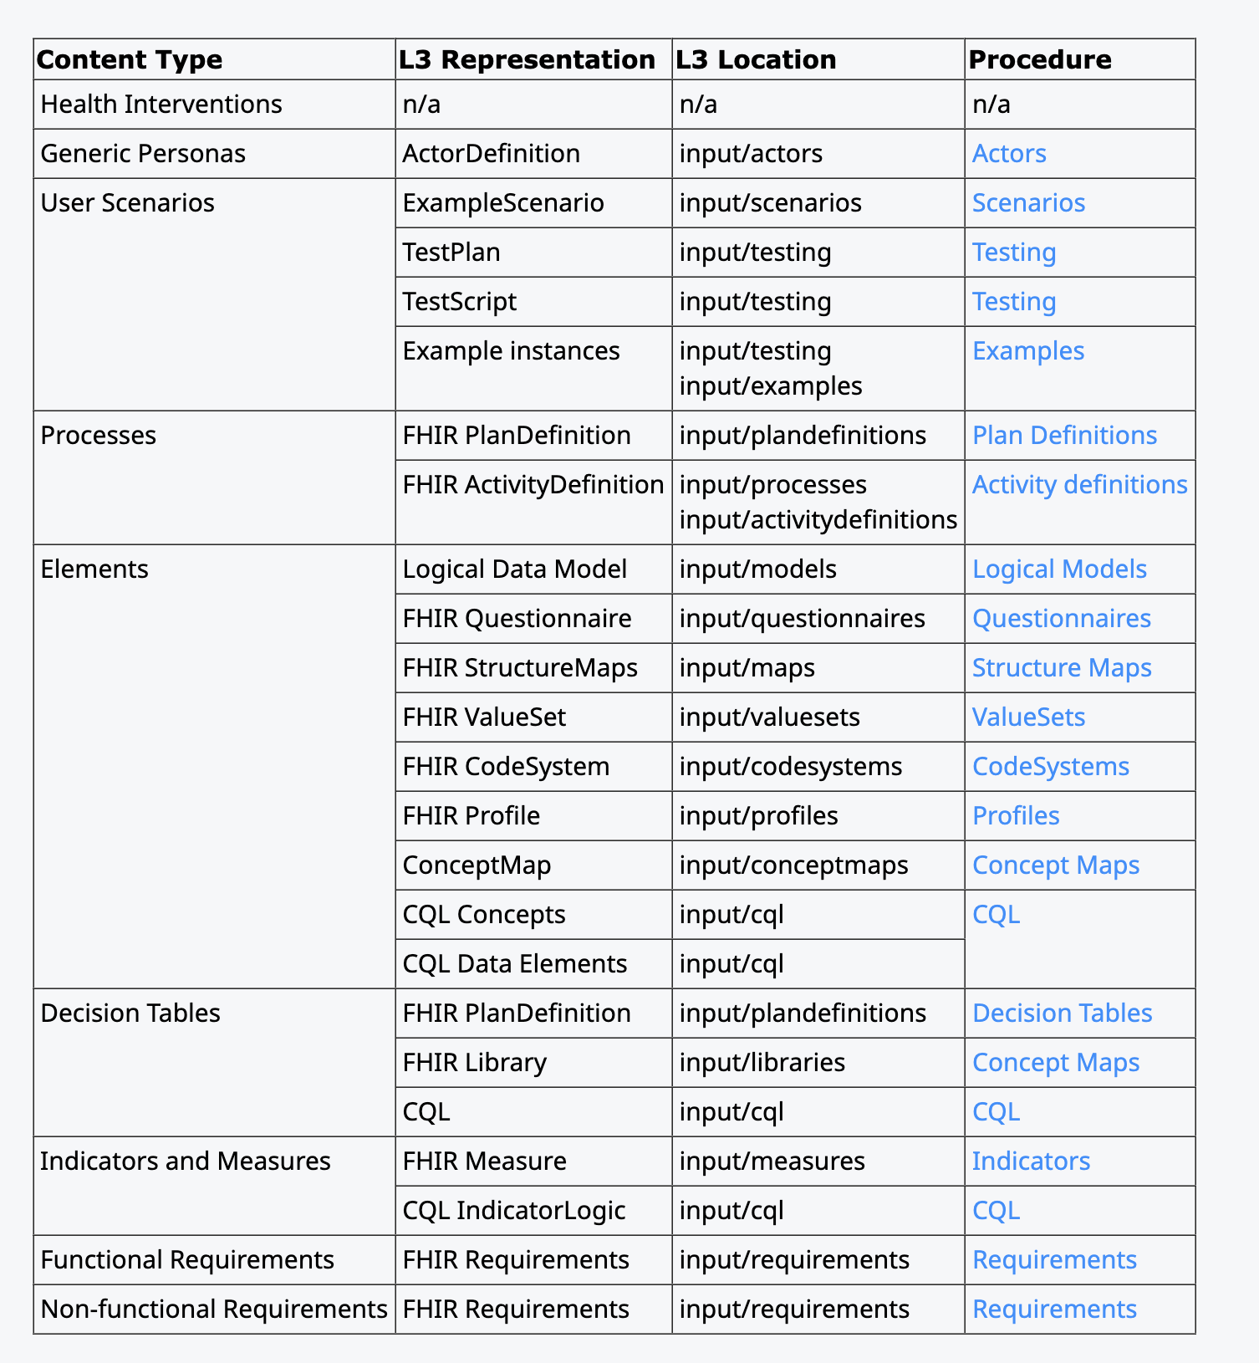
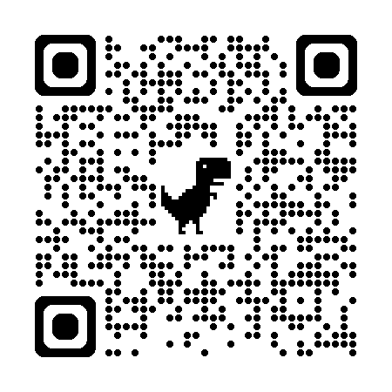
Authoring an L3 FHIR Implementation Guide
Authoring a L3 FHIR Implementation Guide involves taking the L2 input, using the recommended processes and tools, and creating, validating and publishing publishing L3 FHIR artifacts that correspond to the L2 specifications.

Slide 25
FHIR Training Tracks

Slide 26
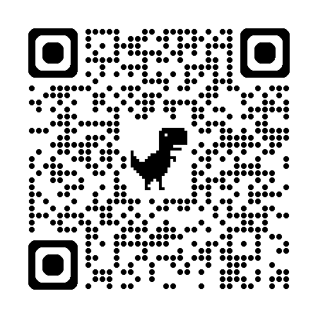
Track A: Introduction to HL7 FHIR Basics
Track B: Advanced Topics in SMART Guidelines and HL7 FHIR
Overview FHIR REST API
FHIR Resources (Patient, immunizations)
Basics of questionnaires Profiling Linkage between profiling and logical models Implementation Guides (IGs) overview
FHIR Profiling (FSH)
Creation of logical models
Resource mapping
Building Questionnaires/structured data capture
FHIR native vs. FHIR hybrid architectures

